Slide 1
Visualizations using Grocery Sales Data
File created on: 3/14/2025
-By
B. Bindu Gayatri

Slide 2
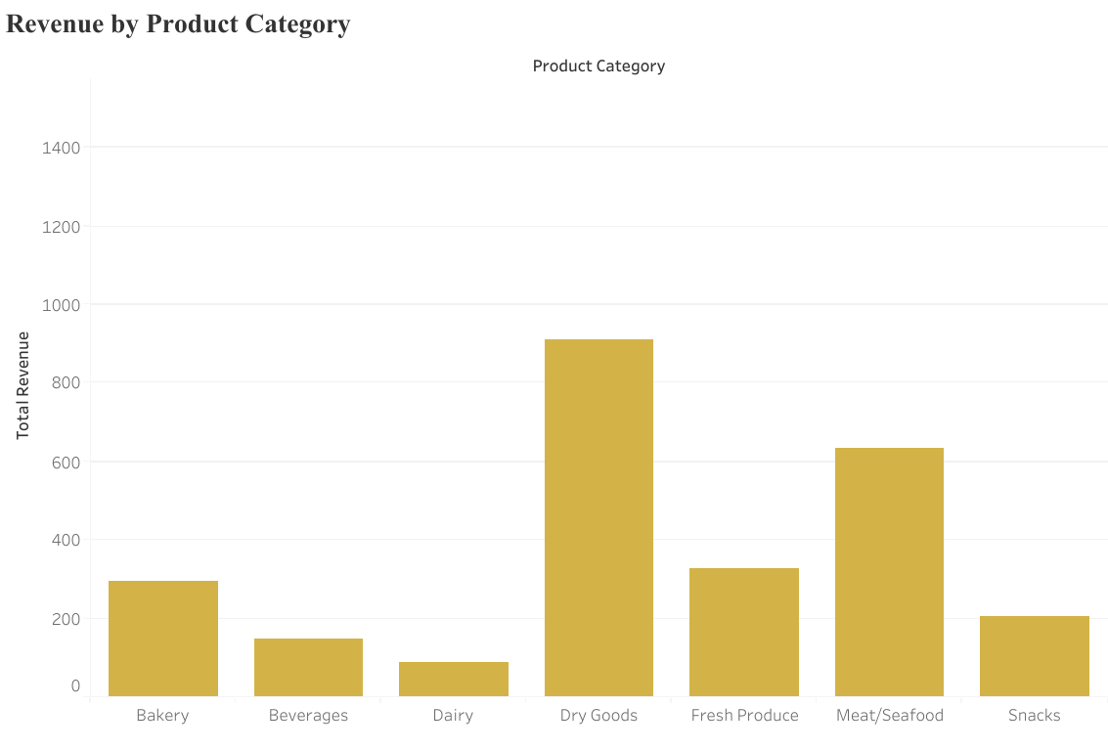

Slide 3
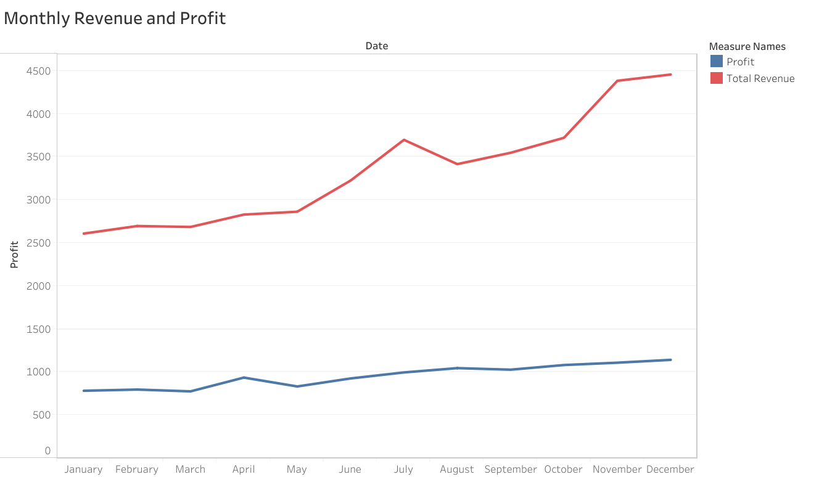

Slide 4
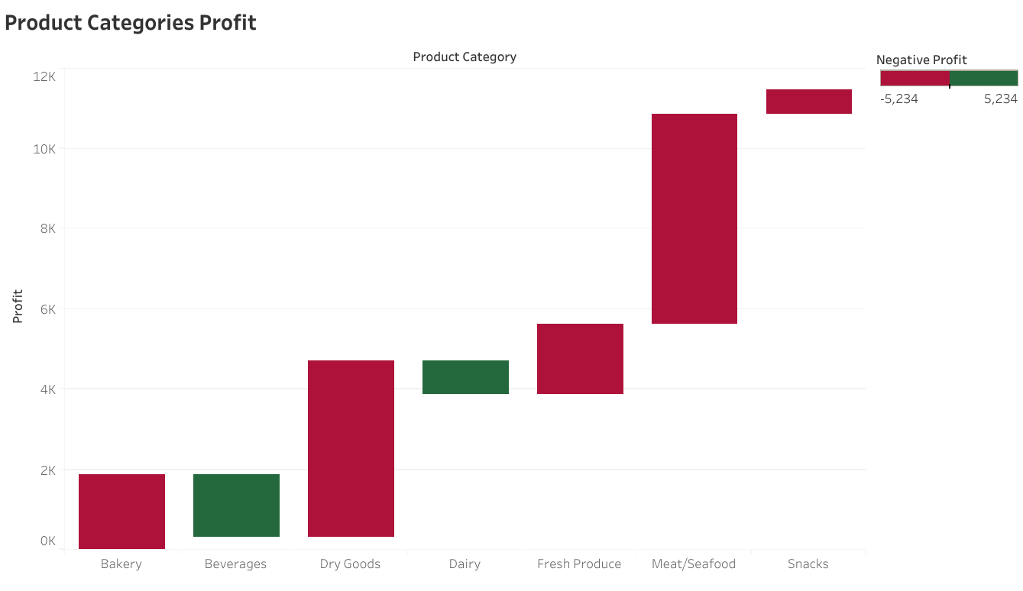

Slide 5
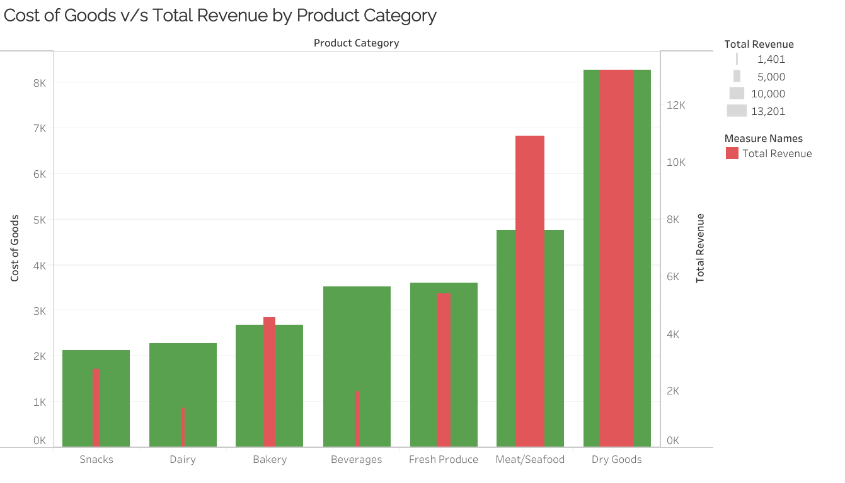

Slide 6
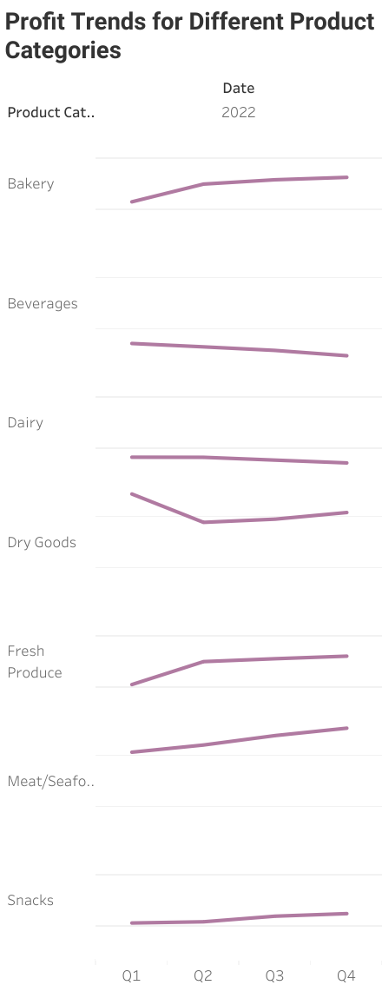

Slide 7
